Slide 1
Dependency Injection
Explanation below
Notes:
Like giving training to a company through external vendor

Slide 2
What is Dependency?
Dependency or dependent means relying on something for support. Like if I say we are relying too much on internet than it means we are dependent on them.
What is dependency in programming means?
When class A uses some functionality of class B, then that class A has a dependency of class B.
We can use methods of other classes, we first need to create the object of that class (i.e. class A needs to create an instance of class B).
What is dependency Injection?
Transferring the task of creating the object to someone else and directly using the dependency is called dependency injection.

Slide 3
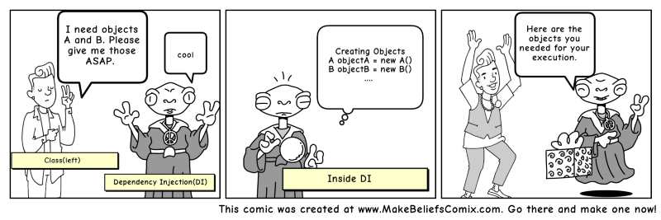

Slide 4
Why should I use dependency injection?
Let’s say we have a car class which contains various objects such as wheels, engine, etc.
What if we decide to ditch MRFtyres in the future and want to use CEAT tyres?
We will need to recreate the car object with a new CEAT dependency. But when using dependency injection (DI), we can change the tyres at runtime
DI is the middleman who will be doing all the work for us
It makes our Car class independent from creating the objects of Wheels, Battery, tyres etc.
There are basically three types of dependency injection:
Constructor Injection
Setter Injection
Interface Injection

Slide 5
Responsibility of Dependency Injection:
Create the objects
Know which classes require those objects
And provide them all those objects

Slide 6
Inversion of control —the concept behind DI
This states that a class should not configure its dependencies statically but should be configured by some other class from outside.

Slide 7
Benefits of using DI
Helps in Unit testing.
Boiler plate code is reduced, as initializing of dependencies is done by the injector component.
Extending the application becomes easier.
Helps to enable loose coupling, which is important in application programming.
Disadvantages of DI
It’s a bit complex to learn, and if overused can lead to management issues and other problems.
Many compile time errors are pushed to run-time.
Dependency injection frameworks are implemented with reflection or dynamic programming. This can hinder use of IDE automation, such as “find references”, “show call hierarchy” and safe refactoring.
You can implement dependency injection on your own or use third-party libraries or frameworks.

